Slide 1
Cloud and demonstration of AWS
Marija Petrovic, Nemanja Kovacevic, Dusan Maric
Novi Sad, 03.06.2023.

Slide 2
Agenda
01
06
Cloud computing
AWS Elastic Load Balancing
02
07
AWS basics
ECS
03
08
S3
Serverless
04
09
EC2
Questions?
05
Amazon Databases

Slide 3

Cloud computing
GREY 2
01

Slide 4
Introduction to cloud computing
Legacy IT or Traditional IT
What is cloud computing
Cloud computing service models

Slide 5
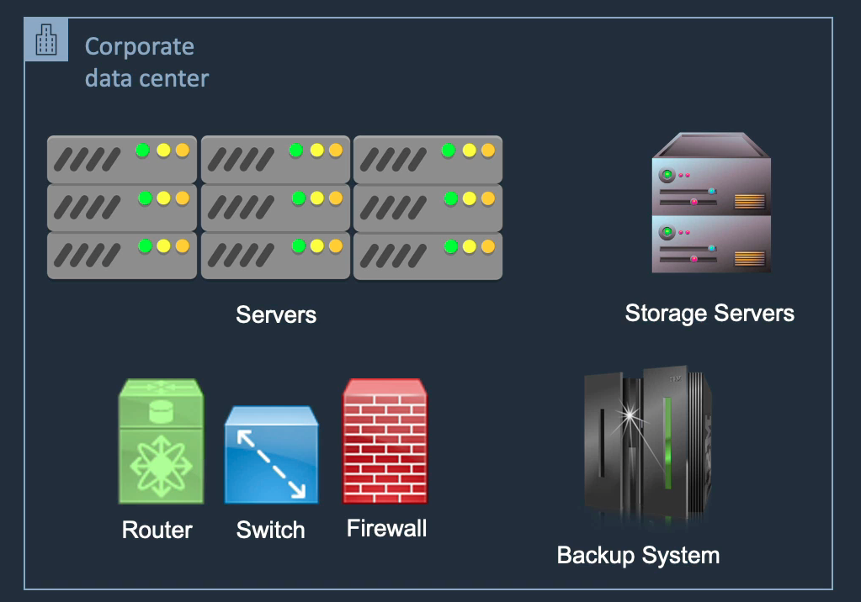
Legacy IT or Traditional IT

Slide 6
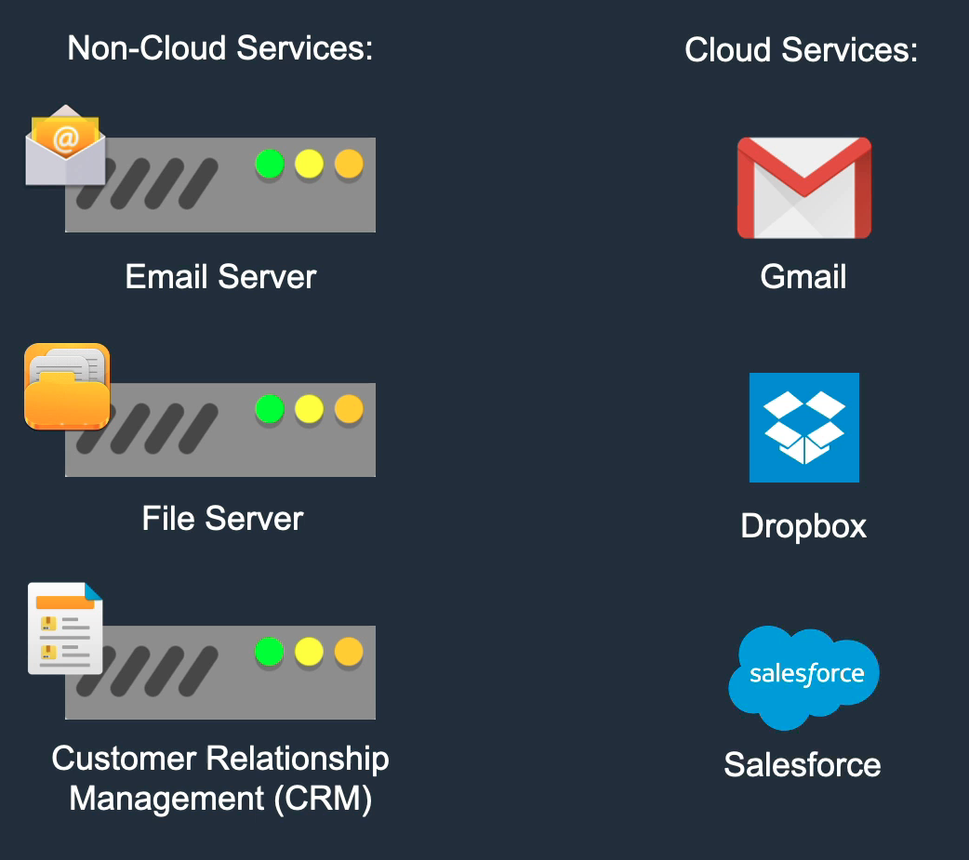
What is Cloud Computing?

Slide 7
Cloud Computing Characteristics
Great availability of resources
On-demand self-service
Easy Maintenance
Large Network Access
Availability
Automatic system
Professional approach
Economical
Security
Pay as you go

Slide 8
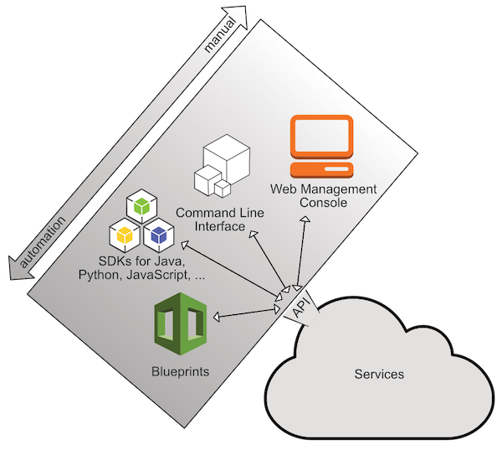
Interacting with AWS
Web Management Console
Command Line Interface
SDKs
Blueprints

Slide 9
Cloud Computing Service Models
Private cloud
Infrastructure as a service (IaaS)
Platform as a service (PaaS)
Software as a service (SaaS)

Slide 10
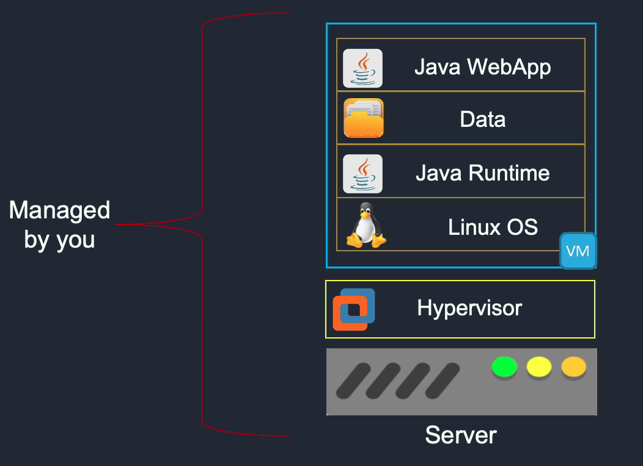
Private CLOUD

Slide 11
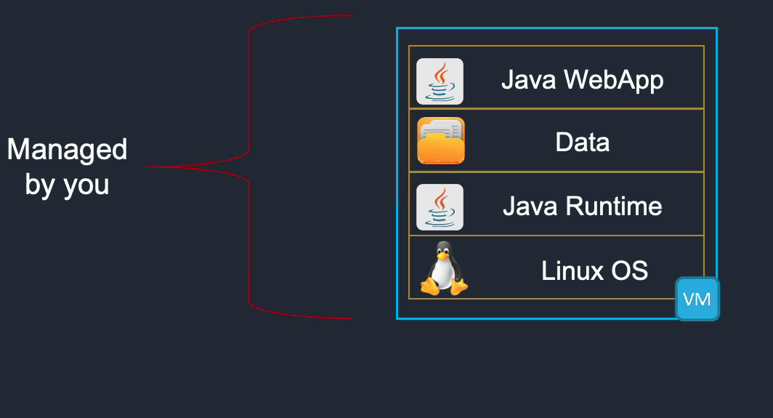
Infrastructure as a service
AWS EC2

Slide 12
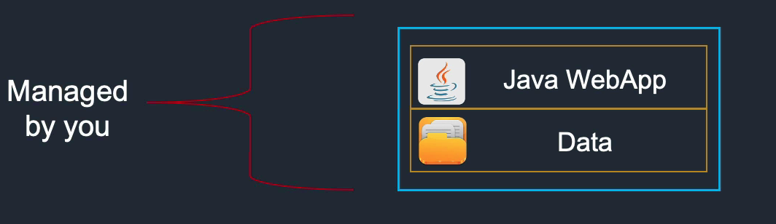
Platform as a service
AWS Elastic Beanstalk

Slide 13
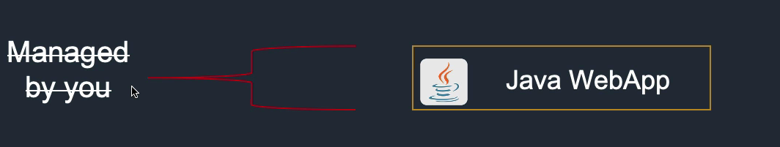
Platform as a service
Salesforce
Google Apps
Dropbox
...

Slide 14

AWS BASICS
GREY 2
02

Slide 15
Amazon web Services (AWS)
Identity and access management – IAM
Amazon simple storage service – S3
Elastic compute cloud - EC2
Amazon RDS – Amazon Relational Database Service
ELB – Elastic Load Balancing

Slide 16
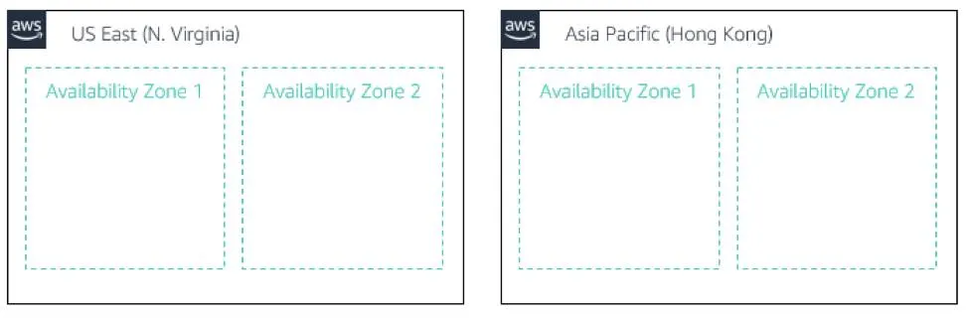
AWS Global infrastructure
AWS runs on AWS global infrastructure
Availability zones
Regions

Slide 17
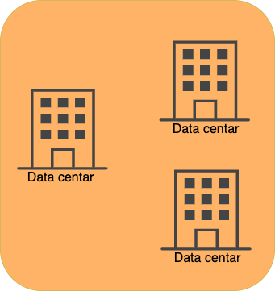
Availability Zones
Consists of one or more data centers.
Currently active 80 availability zones.

Slide 18
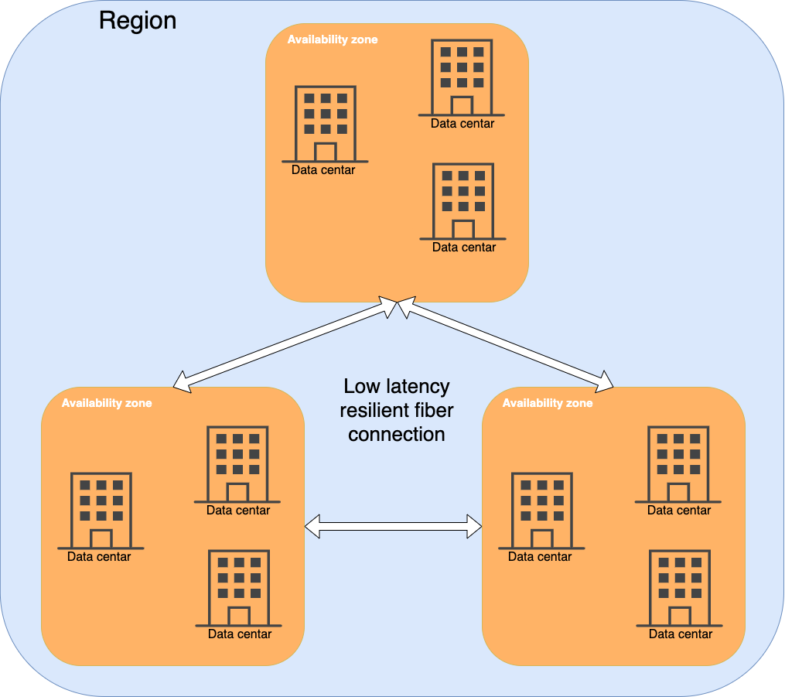
Region
Two or more availability zones
Regions are independent of each others
Connected high speed, low latency fiber connection
Currently active: 25

Slide 19
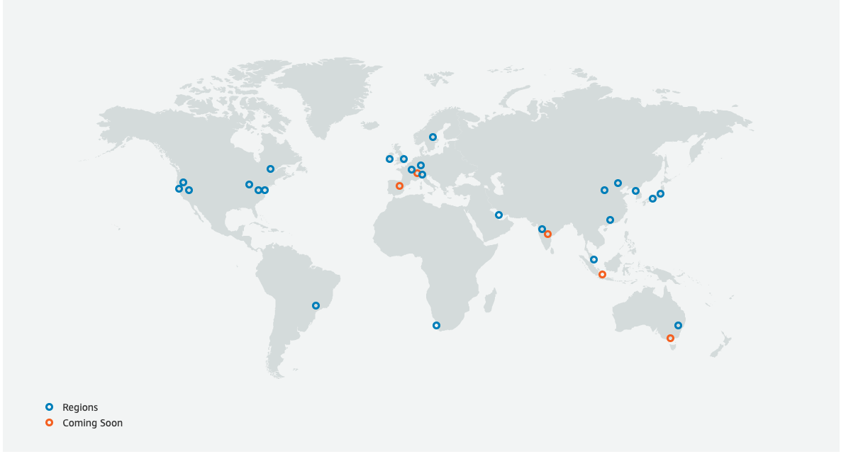
Regions

Slide 20
AWS PRICING
Components that fine payment:
Compute (quantity of resources like CPU and RAM and their usage)
Storage (quantity of stored data)
Outbound data transfer (quantity of data transferred out of AWS)
- Free tier: AWS offers free tier account for one year under which AWS services can be used.
- Billing alarm: good practice is to create billing alarm to manage costs

Slide 21
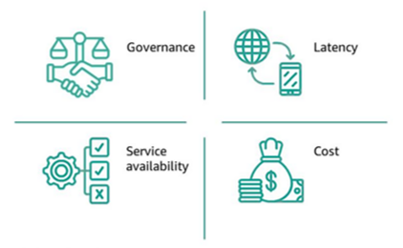
Factors impacting region selection
Governance and legal requirements
Latency
Service availability
Costs

Slide 22
IAM overview
Identity and access management (IAM) – service that allows to manage how is accessed to AWS resources.
Account that created AWS has root access. AWS recommends not to use that account on daily basis and instead each user should have separate user account. For creating and managing user accounts IAM service is used.

Slide 23
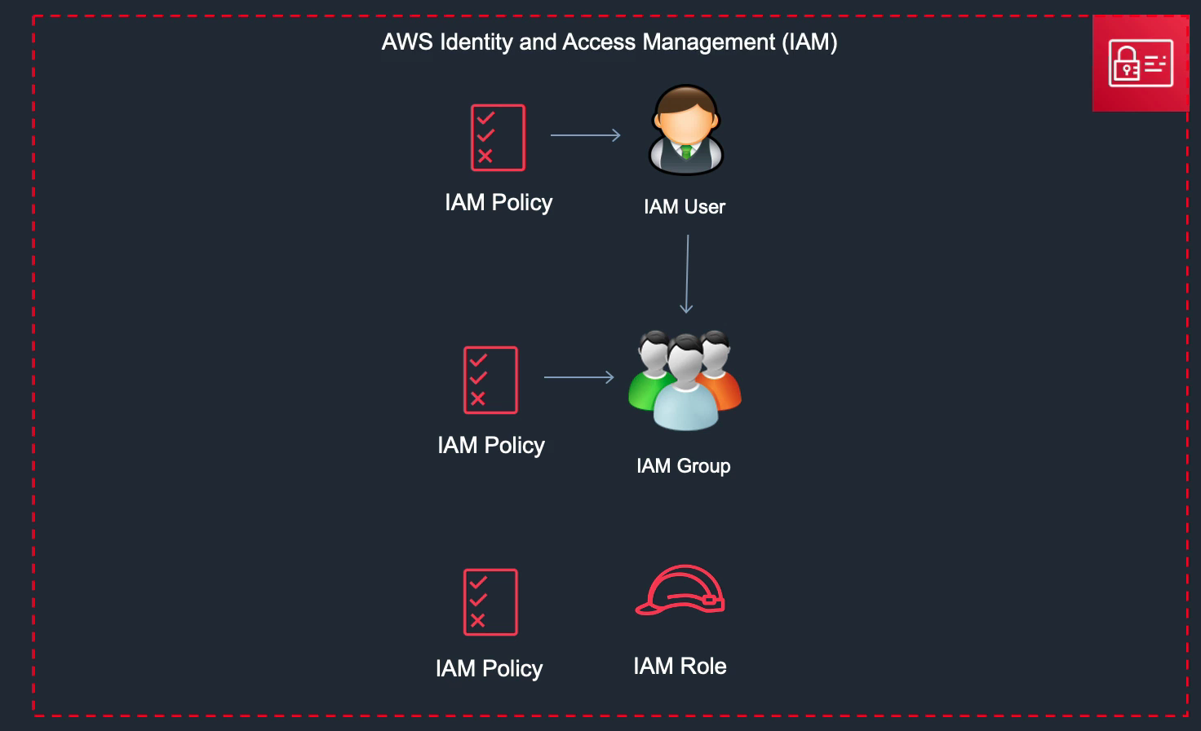
IAM overview
Components of IAM service:
IAM User
IAM Policy
IAM Group
IAM Role

Slide 24
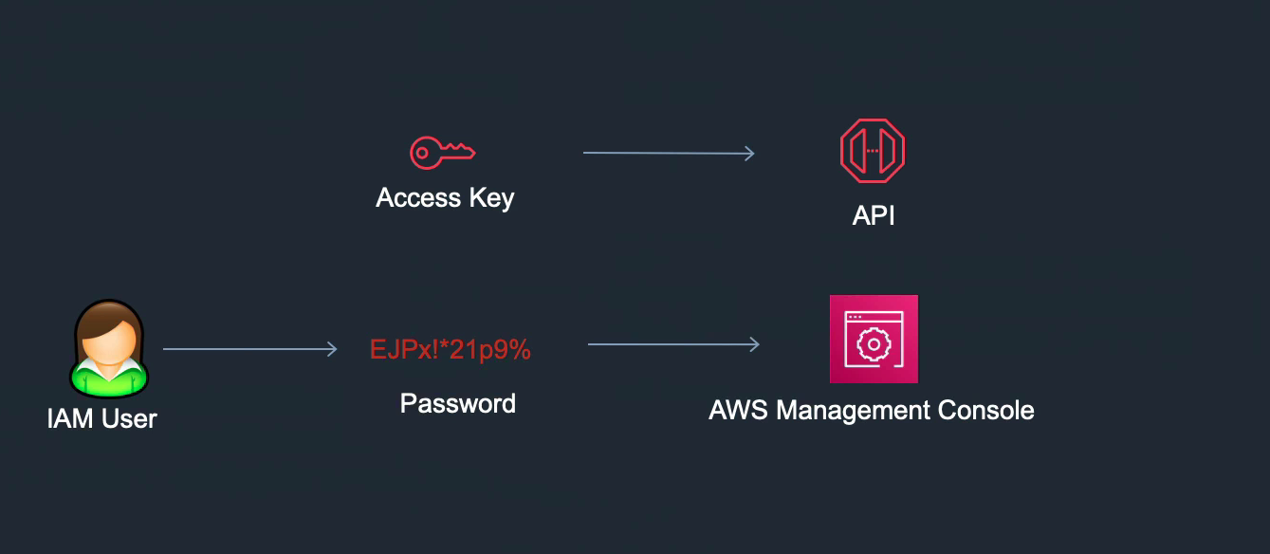
Authentication Method
Access key
Access key id
Secret access key
Used for access to AWS using APIs
Password
Access to AWS management console

Slide 25
Amazon virtual private CLOUD
Virtual space to lunch AWS resources
Default one created automatically
Resembles traditional network
VPC is logically separated part of AWS cloud
VPC is always located in one region
There can be more VPCs in one region
There can be more AZ in one VPC

Slide 26
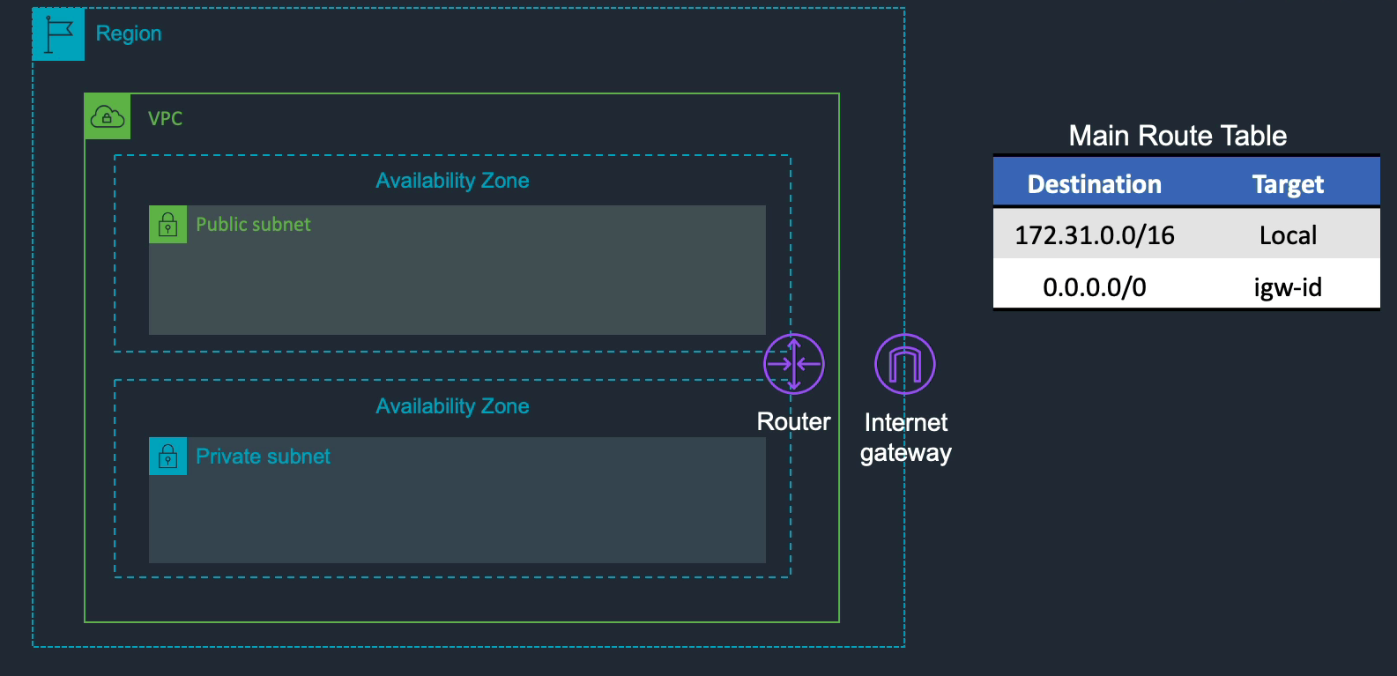
Amazon virtual private CLOUD

Slide 27
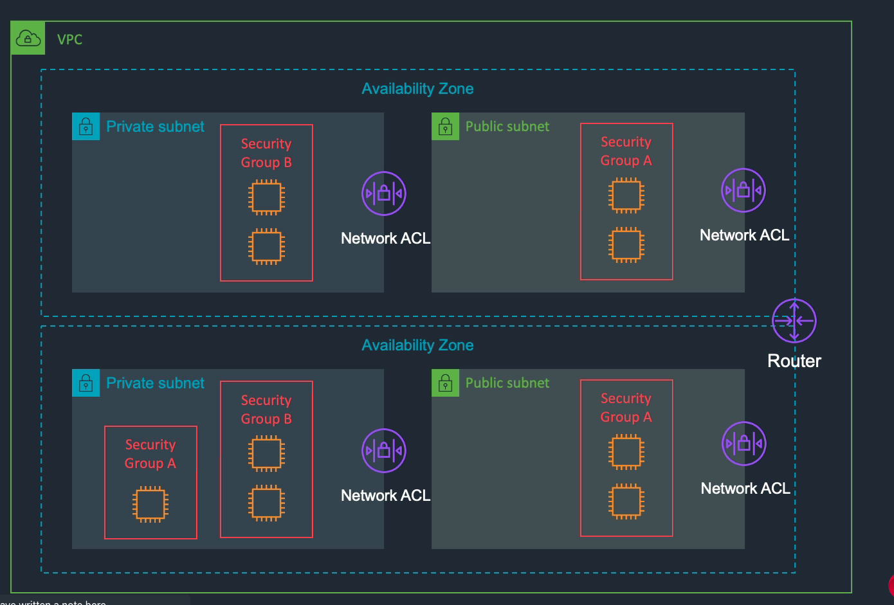
Security GROUPS AND Network ACCESS CONTROL LISTs (NACLs)
- Security groups and network ACLs are types of firewall that can be used to protect AWS resources
- Security groups are applied on instance levels (e.g EC2) to control traffic that reach or go out from instances
- Network ACLs are applied on subnet level

Slide 28
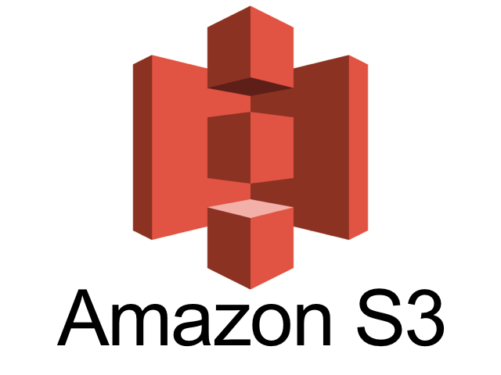
AMAZON simple storage service (s3)
GREY 2
03

Slide 29
Amazon s3 overview
Amazon Simple Storage Service (S3) – is cloud-based storage that can store unlimited amount of data and retrieve data anytime over the web.
Highly scalable, reliable, fast and cost-effective data storage built on Amazon’s global infrastructure

Slide 30
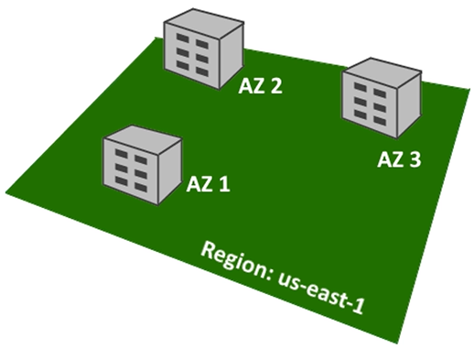
S3 storage
Your data is stored in region
You chose a region for your data
Data is replicated across 3 availability zones
Amazon handles AZ replication
S3 is object-based storage (file = object)
Objects are stored in buckets
Bucket name must be unique
No hierarchy
An object can be up to 5TB
No limit on bucket size or total data in your account

Slide 31
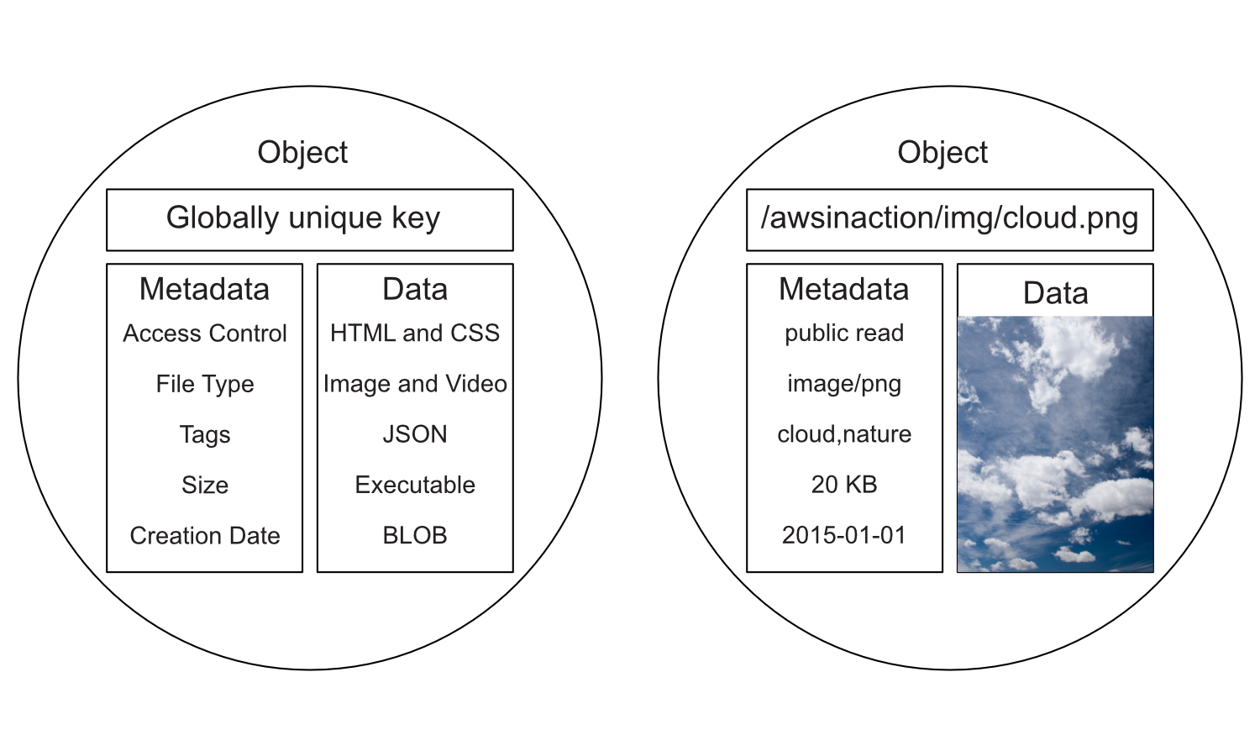
What makes up an object
Key – this is a name of object
(/my-bucket/my-folder/my-object.txt)
Value – any sequence of bytes you want to store
Metadata
Name-value pairs to store information about the objects
System metadata – creation data, size, storage class …
User metadata – is custom metadata you add to an object

Slide 32
Storage classes
STANDARD STORAGE
best when you need quick access, frequently
STANDARD INFREQUENT ACCESS
Use when you need data to be returned quickly but not frequently
Min storage timeframe 30 days
ONE ZONE INFREQUENT ACCESS
Use when you have another copy or data can be re-created
Cheaper but data is only replicated in one AZ
GLACIER
Used for long term archive and backup
Min timeframe 90 days, can take minutes to hours to retrieve

Slide 33
Tags
WHAT ARE OBJECT TAGS?
A key-value pair
Tags are used to categorizing storage
USE CASES
Use tags to allow a user/group to read/write objects with a tag
Create lifecycle rules to move objects based on a tag to cheaper storage tiers
Use as filter for analytics and metrics
Track costs based on tag

Slide 34
Object metadata
Object metadata is descriptive data describing an object
Consist of a name-value pairs
Returns as HTTP headers on objects
Two type of metadata
System metadata (maintained by Amazon)
Metadata where only Amazon can modify the value (object creation date)
Metadata that you can modify (storage class, encryption attributes …)
User defined metadata
Custom name-value pairs you can add to an object
Name must begin with “x-amz-meta”

Slide 35
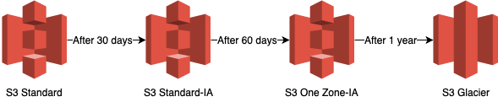
lifecycle and optimising storage costs

Slide 36
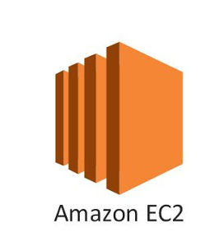
AMAZON ELASTIC COMPUTE CLOUD (EC2)
GREY 2
04

Slide 37
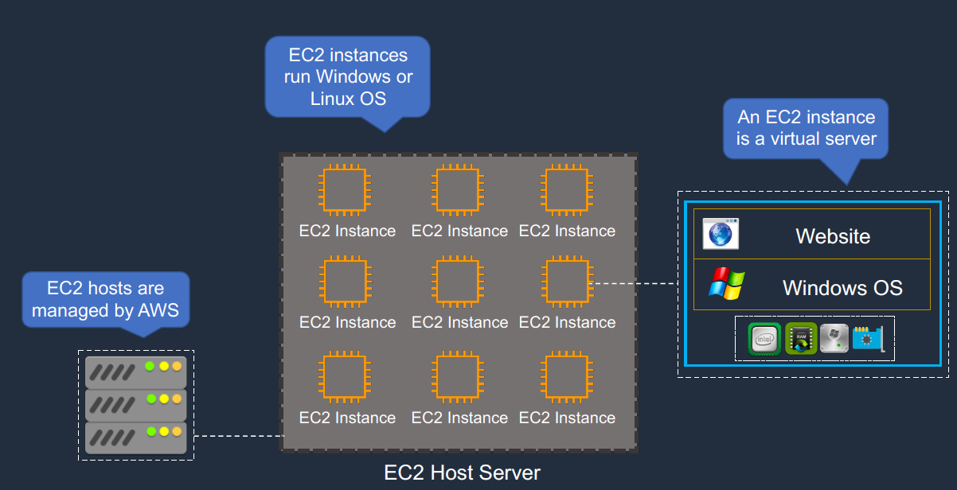
EC2
EC2 instance is a virtual server running on AWS
There are physical servers that run the virtualization but that is managed by AWS
EC2 instance has allocated
CPU
RAM
Drive space
Network bandwidth
EC2 has Operating system - Linux, Window or Mac OS
EC2 will have running applications
EC2 UserData – Bootstrap script only run once at the instance first start
(installing updates and software, downloading files from the internet etc. )

Slide 38
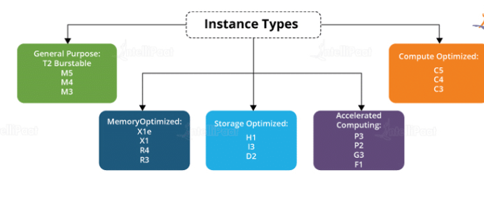
EC2 INSTANCE TYPES
You can use different types of EC2 instances that are optimized for different use cases: https://aws.amazon.com/ec2/instance-types/
AWS has the following naming convention:
m5.2xlarge
m : instance class
5 : generation (AWS improve them over time)
2xlarge : size within the instance class

Slide 39
EC2 IP ADDRESS
EC2 instance must have IP address assigned to it
Type | Description
Public IP address | You can connect to it through the internet Must be unique across the whole web Lost when the instance is stopped Associated with private IP address on the instance

Slide 40
EC2 IP ADDRESS
EC2 instance must have IP address assigned to it
Type | Description
Private IP address | EC2 instance always have private IP address Private IP address for internal use Must be unique across the private network Retained when the instance is stopped

Slide 41
EC2 IP ADDRESS
EC2 instance must have IP address assigned to it
Type | Description
Elastic IP address | Static Public IP address Can be access through internet IP address is not lost when you stop the instance You are not charged if you are using it You are charged if you not use it Associated with a private IP address on the instance Can be moved between instances

Slide 42
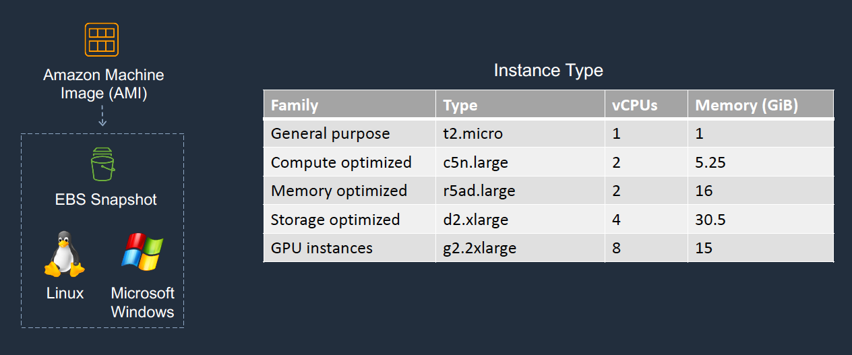
Launching AN AMAZON EC2 instance
We choose an AMI
It has already installed OS
It can have certain configuration applied to it
It can have data preloaded if you create your image
Choose an instance type
T2.micro part of free tier

Slide 43
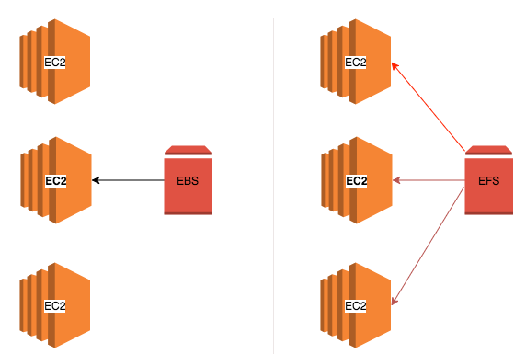
EC2 Instance storage
EBS – Elastic Block Store
It allows you instance to persist data
It is a network drive, uses network to communicate the instances, there might be a bit of latency
Analogy : think of them as a “network USB stick”
Can be detached from one instance and attached to another
It is locked to one availability zone
It have provisioned capacity
EFS – Elastic File System
Can be mounted to many instances in many AZ
Highly available, scalable, expensive
Compatible with Linux based AMI (not Windows)
File system scales automatically, pay per use, no capacity planning

Slide 44
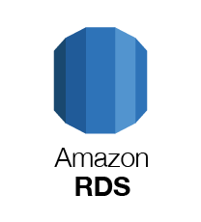
AWS Databases
GREY 2
05

Slide 45
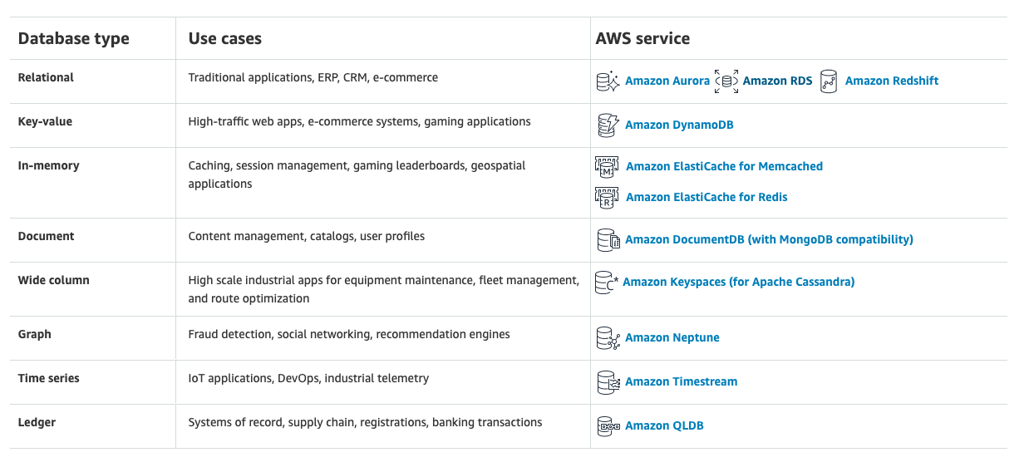
AWS Databases

Slide 46






Amazon RDS
Relational Database Service
Is managed relational database
OS patching and backups managed by AWS
Runs on EC2
Easily scalable vertical and horizontal
Engines
MySQL
PostgreSQL
Microsoft SQL
Amazon Aurora
MariaDB
Oracle

Slide 47
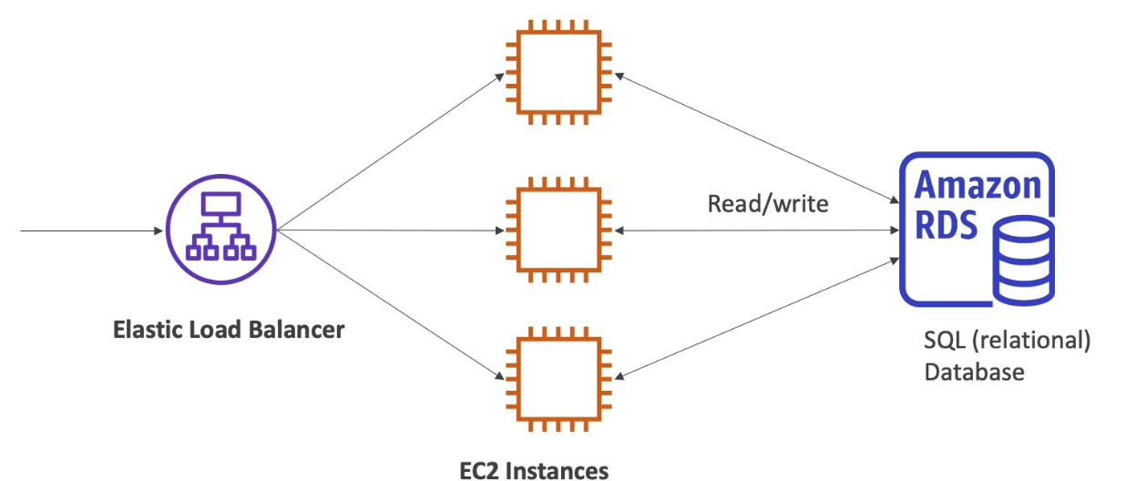
RDS solution Architecture

Slide 48
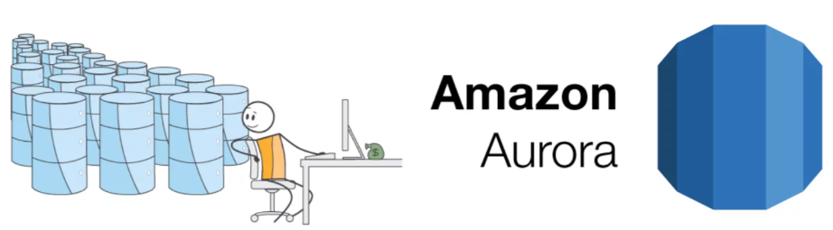
Amazon Aurora
Proprietary technology from AWS (not open source)
PostgreSQL and MySQL are both supported by Aurora
“AWS cloud optimized” – claim 5x performance improvement of MySQL on RDS, over 3x performance of PostgreSQL on RDS
Aurora storage automatically grows in increments of 10GB, up to 64TB
Aurora costs 20% more than RDS – but is more efficient
Not in the free tier

Slide 49
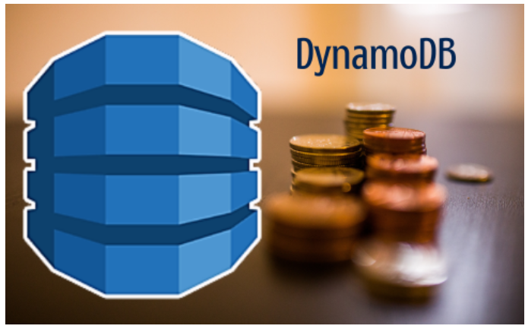
Amazon DyNAMODB
Fully managed, highly available with replication across 3 AZ
Scales to massive workloads, distributes “serverless” database
Single digit – millisecond latency
Key value DB -https://aws.amazon.com/nosql/key-value/

Slide 50
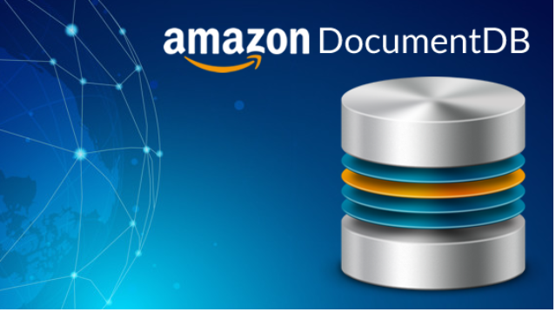
DOCUMENT db
AWS implementation for Mongo DB – NoSQL DB
Mongo DB is used to store, query and index JSON data
OS patching and backups managed by AWS
Fully managed, highly available with replication across 3 AZ

Slide 51
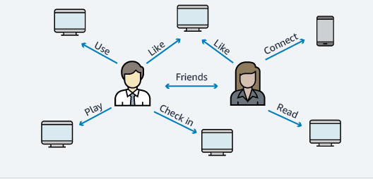
Amazon NEptune
Fully managed graph database
Example for graph dataset – social network
Highly available across 3 AZ, with up to 15 read replicas
Optimized for complex queries
Can store up to billions of relations and query the graph with millisecond latency
Great for knowledge graphs (Wikipedia), fraud detection, social networking

Slide 52
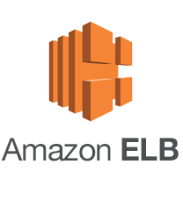
AWS Elastic Load balancing (ELB)
GREY 2
06

Slide 53
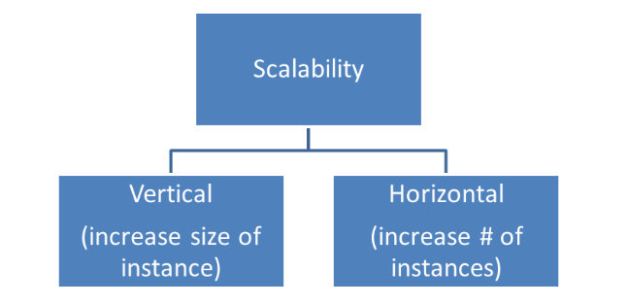
Scalability/High availability/elasticity
Scalability means that application can handle greater loads by adapting
Vertical scalability – increasing the size of the instance: t2.micro t2.xlarge
Vertical scalability is very common for non distributed systems, such as a database
RDS, Elasticache can scale vertically
Limit is hardware limit
Horizontal scalability – increasing the number of the instances/systems for your application
Horizontal scaling implies distributed systems
Can be easily done with AWS

Slide 54
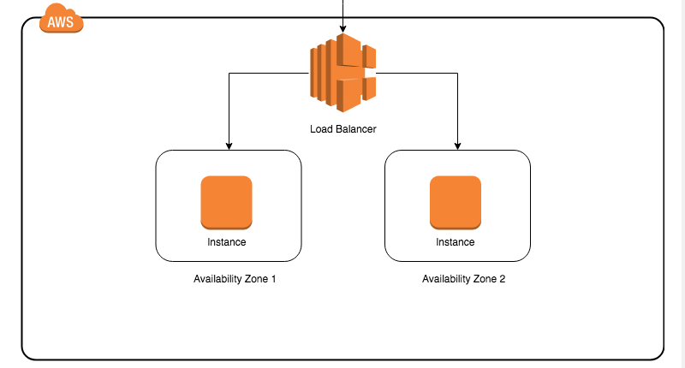
High availability usually goes hand in with horizontal scaling
High availability means running your application in at least 2 AZ
The goal of high availability is to survive a data center loss
Can be easily done with AWS
Elasticity – once a system is scalable, elasticity means that there will be some “auto scaling”:
The system scale based on loads
This is cloud friendly: pay per use, match demand you are receiving, optimize costs

Slide 55
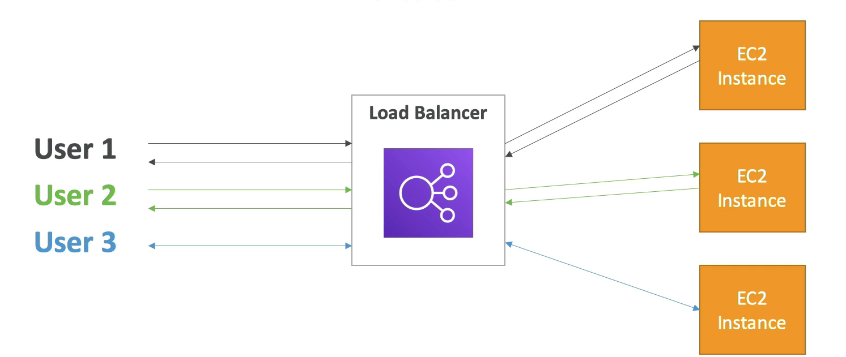
What is Load balancing?
Load balances are servers that forward traffic to multiple servers (e.g EC2 instances) downstream

Slide 56
Why Use load balancer?
Spread load across multiple downstream instances
Expose a single point of access (DNS) to the application
Seamlessly handle failures of downstream instances
Do regular health checks to instances
Know when not to send traffic to it
High availability across zones

Slide 57
Amazon Elastic Load balancing
Elastic load balancer is managed load balancer:
AWS guarantees that it will be working
AWS takes care of upgrades, maintenance, high availability
Multiple types of ELBs:
Application Load Balancer (ALB) (v2 – new generation, 2016 – HTTP, HTTPs, WebSocket)
Network Load Balancer (NLB) (v2 – new generation, 2017 – TCP, TLS, UDP
Gateway Load Balancer (GLB) (2020, operates at layer 3- Network layer)
Classic Load Balancer (CLB) (v1 – old generation, 2009 – HTTP, HTTPS, TCP, SSL) - deprecated
Recommended to use new generation load balancers as they provide more features

Slide 58
Application Load balancer
Application load balancer is layer 7 (HTTP)
Load balancing to multiple HTTP applications across machines (target groups)
Load balancing to multiple applications on the same machine
Supports redirects (from http to https for example)
Routing tables to different target groups:
Routing based on path in URL (example.com/user & example.com/posts)
Routing based on hostname in url (one.example.com & other.example.com)
Routing based on Query String, Header (example.com/users?id=123&order=false)
ALB are great fit for microservices & container-based application (example: Docker & Amazon ECS)

Slide 59
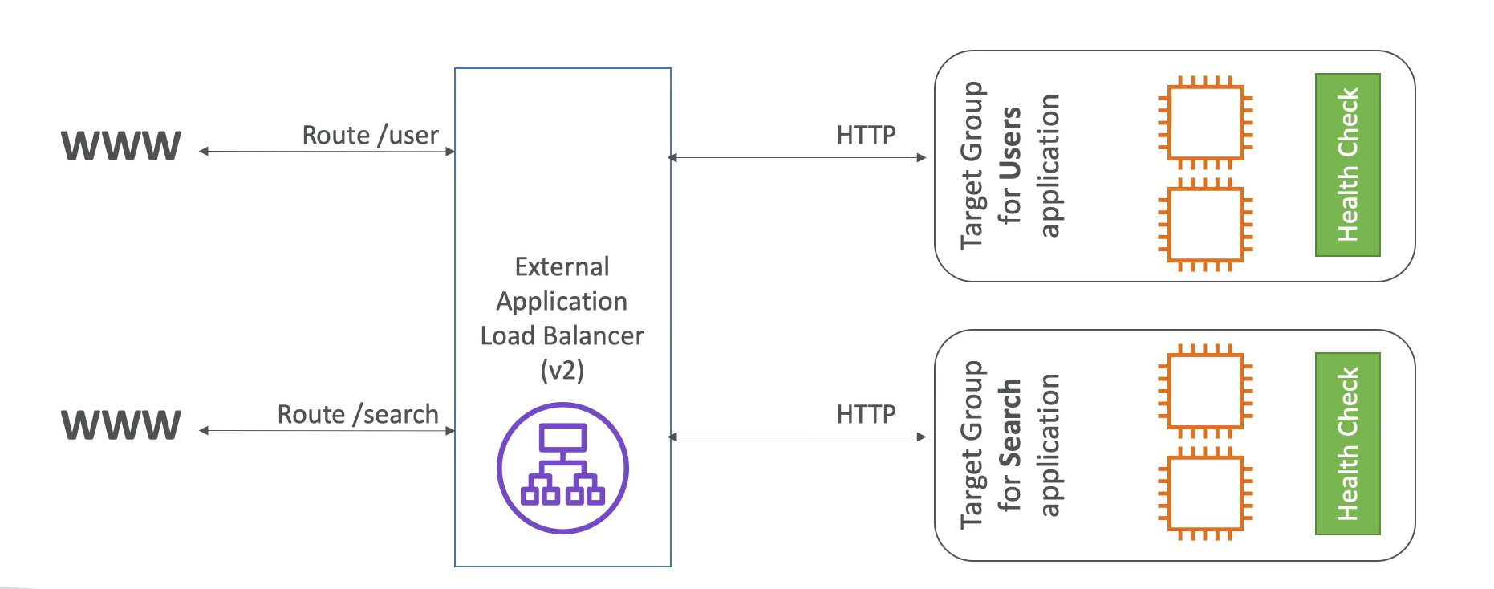
Application Load balancer

Slide 60
ALB – Target groups
EC2 instances (can be managed by an Auto Scaling Group)- HTTP
Lambda functions - HTTP request is translated into a json event
IP addresses - must be private IP

Slide 61
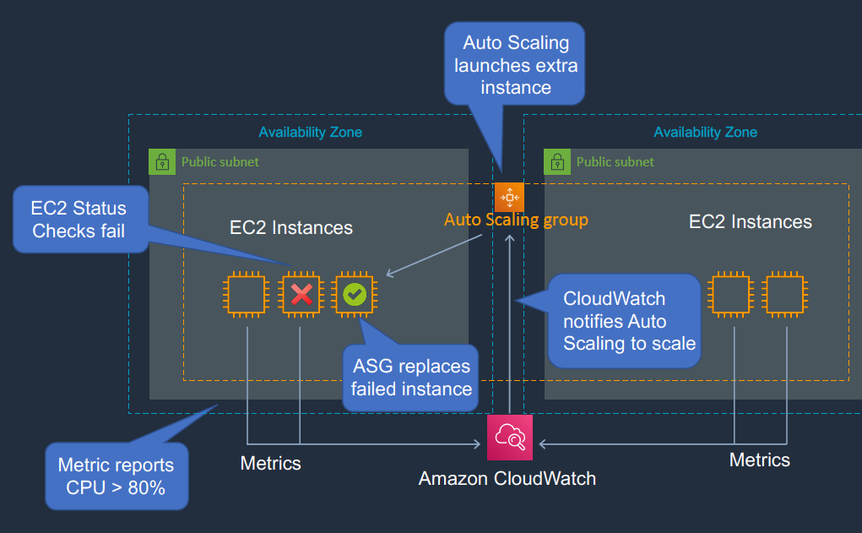
Amazon EC2 Auto scaling
Auto Scaling group add elasticity to our EC2 instances
Auto Scaling can launch new instances or terminate existing EC2 instances
EC2 instances are sending information to CloudWatch
CloudWatch is sending information to Auto Scaling group
EC2 Status check fails, launch new instance to replace it
Load above some threshold add new instance, scale up
Load below some threshold terminate ec2 instance, scale down

Slide 62
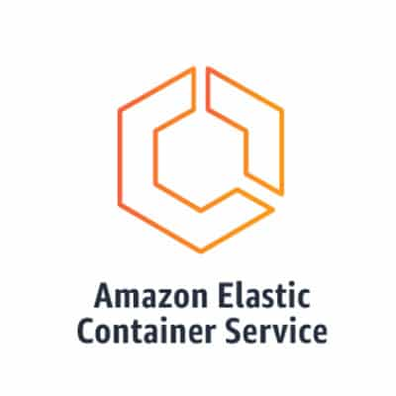
AWS Elastic Container service (ECS)
GREY 2
07

Slide 63
ECS and Fargate - Introduction
ECS – Elastic Container Service
ECS is highly scalable, fast, container management service that makes it easy to run, stop and manage Docker containers on cluster
Amazon ECS eliminates the need for us to operate our own cluster management and configuration management systems or worry about scaling our management infrastructure
Fargate – Serverless Container Service
We can host our cluster on a serverless infrastructure that is managed by Amazon ECS by launching our services or tasks using the Fargate launch type.

Slide 64
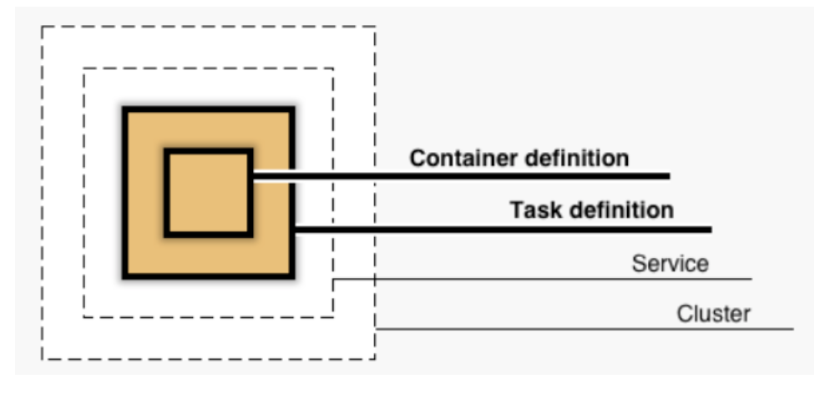
ECS Objects
Container definition
Container image, port, registry, Environment Variables to pass to container …
Task definition
A task definition is a blueprint for our application and describes one or more containers through attributes.
Service
A service allows you to run and maintain a specified number (the "desired count”, autoscaling) of simultaneous instances of a task definition in an ECS cluster.
Cluster
Cluster is a logical grouping of resources that are used to run containerized applications.

Slide 65
ECS Objects
Task
A task is the instantiation of a task definition within a cluster.
After we have created a task definition for our application within Amazon ECS, we can specify the number of tasks that will run on our cluster (run task directly or configure to run from a service).

Slide 66
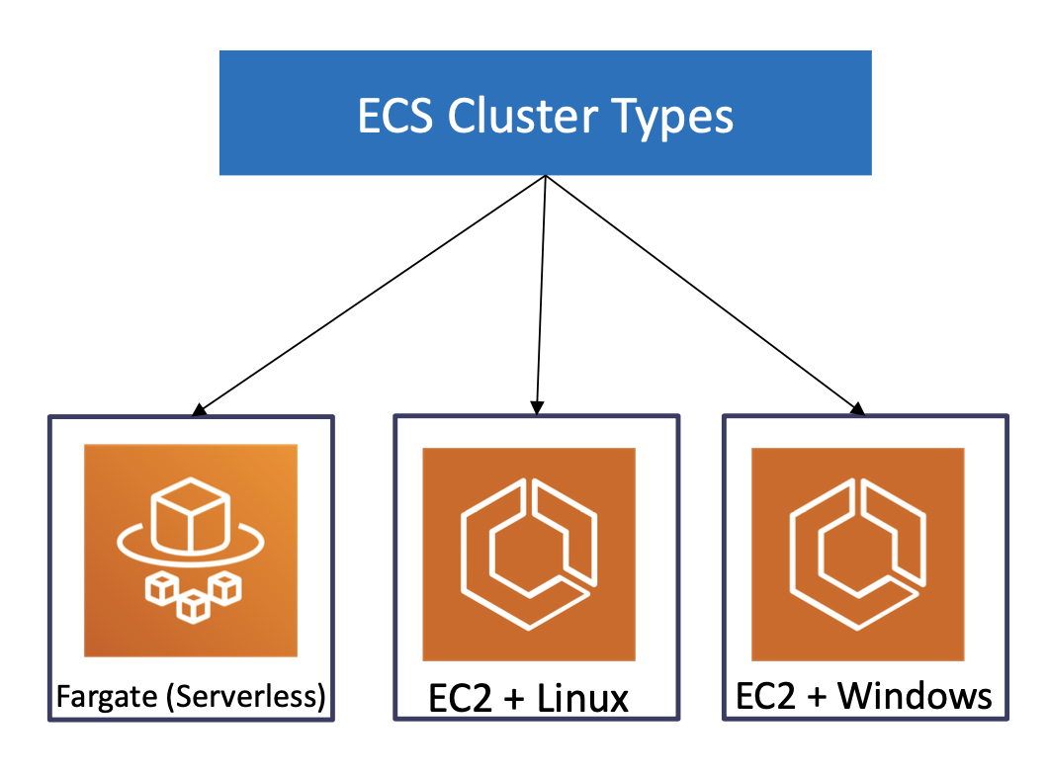
ECS Cluster types
We have 3 types of cluster templatesavailable in ECS
Fargate – Serverless (default)
EC2 – Linux
EC2 - Windows
Clusters are Region-specific

Slide 67
Aws Fargate – pros
Serverless
Fargate is a serverless offering, which means you don't have to manage or maintain any underlying infrastructure. AWS handles the scaling, availability, and maintenance of the underlying resources for you.
Cost effective
You only pay for the resources you use, which can be more cost-effective than running your own EC2 instances.
Scalability
Fargate can scale automatically based on the demands of your workload, without you having to worry about managing and scaling EC2 instances.
Security
Fargate offers built-in security features such as isolation between tasks, IAM roles for tasks, and automatic OS patching.

Slide 68
Aws Fargate – CONS
Limited control
Fargate abstracts away the underlying infrastructure, which means you have limited control over the underlying resources and networking
Limited customizability
Since Fargate is a serverless offering, you have limited options for customizing the operating system and runtime environment
Limited availability zones
Fargate is currently only available in a limited number of AWS regions and availability zones

Slide 69
Aws EC2– PROS
Full control
EC2 gives you full control over the underlying infrastructure, allowing you to customize and configure the environment to your specific needs
Greater flexibility
With EC2, you have more options for customizing your runtime environment and the operating system
Availability zones
EC2 is available in all AWS regions and availability zones, giving you greater flexibility for deploying your applications

Slide 70
Aws EC2– cons
Maintenance
With EC2, you are responsible for maintaining and patching the underlying infrastructure, which can add operational overhead
Scalability
Scaling EC2 instances requires manual intervention or use of Auto Scaling groups
Cost
EC2 instances can be more expensive than Fargate due to the need to manage and maintain the underlying infrastructure

Slide 71
Workload vs price
larger, long-running workloads
often more cost-effective to use EC2 instances, especially if you can take advantage of reserved or spot instances to reduce the cost even further
small workloads or workloads with highly variable traffic
Fargate allows you to pay only for the resources that you use, with no upfront costs or long-term commitments
AWS Price calculator and AWS Cost Explorer

Slide 72
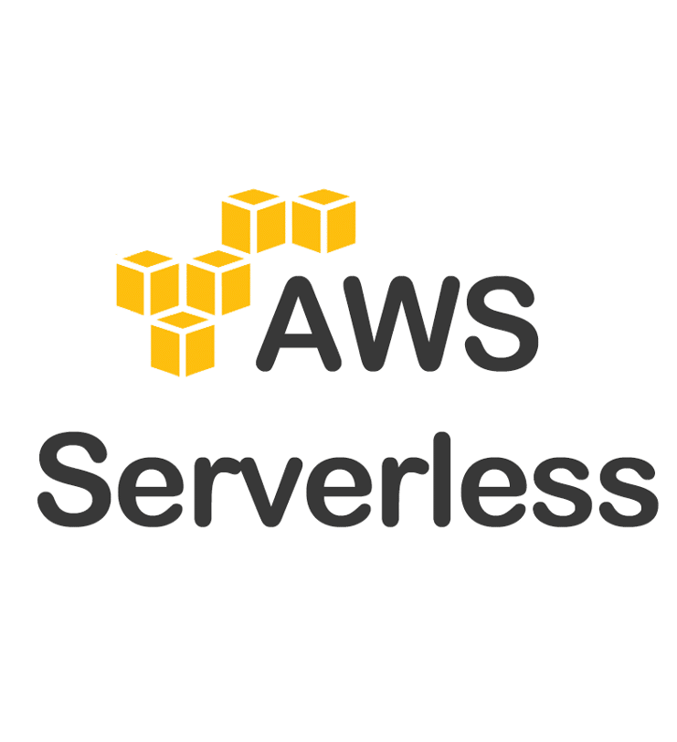
Serverless
GREY 2
08

Slide 73
What is serverless?
Serverless does not mean there are no servers, it means you just do not manage, provision, or see them.
Servers are abstracted away from app development – AWS handles the routine work of provisioning, maintaining, and scaling the server infrastructure.
In AWS, serverless applications start with AWS Lambda, but now they include anything that is managed (databases, storage, messaging).
Pay as you go model (You only pay when you use it)

Slide 74
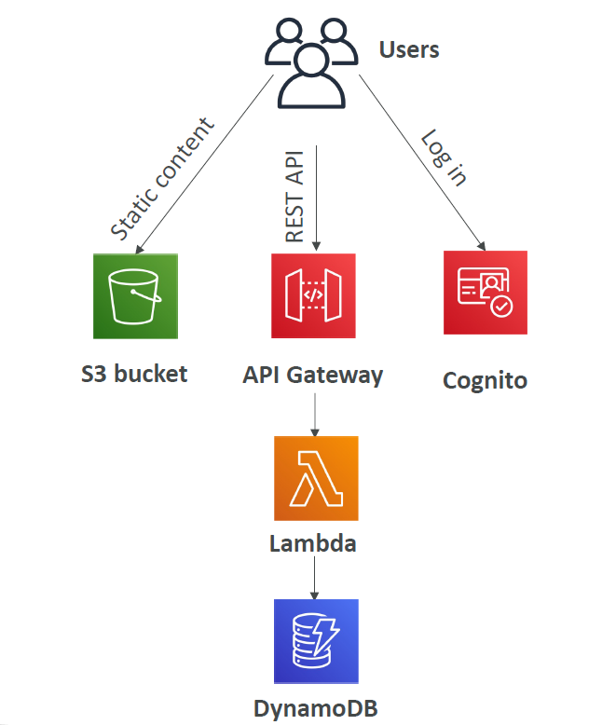
Serverless services on AWS
AWS Lambda
AWS API Gateway
DynamoDB
Amazon S3
AWS Cognito
Amazon SNS (Simple Notification Service)
Amazon SQS (Simple Queue Service)
AWS Kinesis Data Firehose
...

Slide 75

AWS Lambda
Runs your code that is organized into Lambda functions on a high-availability compute infrastructure.
All you need to do is to supply your code in one of the language runtimes that Lambda supports – Java, Python, Node.js, C#, Golang, etc...
The Lambda runs your function only when needed and scales automatically.
You pay per request and compute time.
It easily can be integrated with many AWS services (API Gateway, S3, Cognito, DynamoDB...)

Slide 76

AWS API Gateway
A service for creating, publishing, maintaining, securing, and monitoring RESTful and WebSocket APIs at any scale.
You can run multiple versions of the same API simultaneously, in different environments, so you can quickly test and release new versions.
Handles accepting and processing up to hundreds of thousands of concurrent API calls, traffic management, CORS support, etc...
Has powerful authentication mechanisms (integration with AWS IAM, Cognito, or Lambda authorizer functions).
You only pay for the API calls you receive and the amount of data transferred out.
AWS Lambda + AWS API Gateway = NO INFRASTRUCTURE TO MANAGE

Slide 77

Amazon Cognito
Provides authentication, authorization, and user management for your web and mobile applications.
Two main features: Cognito User Pools and Cognito Identity Pools
With User Pools, users can sign in directly with username/email and password, or through a 3rd party (Facebook, Google, Apple), reset password, enable MFA, verify their accounts using email or phone number, etc...
It easily can be integrated with API Gateway and Application Load Balancer.
With Identity Pools, users can obtain temporary AWS credentials to access (directly or through API Gateway) AWS services.
It support different users sources: Cognito User Pools, 3rd party logins, SAML identity providers, OpenID Connect (OIDC) providers, etc...

Slide 78

Questions?
GREY 2
09

Slide 79
Thank you
Serbia / Novi Sad
Levi9 Global Sourcing Balkan d.o.o.
Novi Sad Offices
Trifkovicev Trg 4
21000 Novi Sad, Serbia

